Slide 1

Diabetic retinopathy diagnostic system
Raghav Agarwal​ guide: Deepthi Godavarthi

Slide 2

Agenda
Introduction
Primary goals
Areas of growth
Timeline
Summary

Slide 3
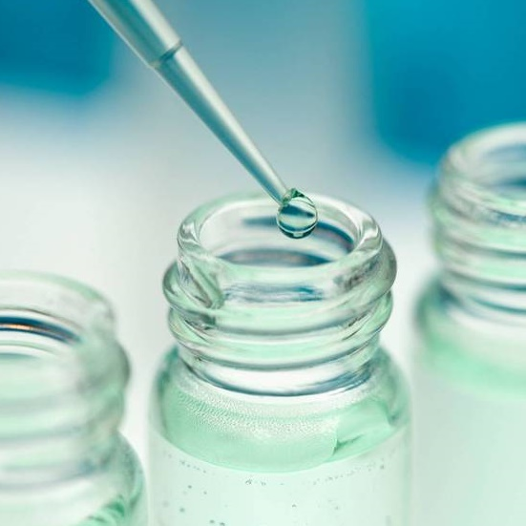
Introduction
Diabetic retinopathy, the primary cause of vision loss, poses a significant risk to diabetics. Diabetic Retinopathy Detector empowers patients to self-monitor their eye health, enabling early detection and timely treatment to prevent irreversible vision loss. This combination is determined to emphasize preventive health care and patient empowerment.
The healthcare landscape is constantly evolving, driven by technological advances, changing patient needs, and the emergence of new diseases and conditions. In this dynamic environment, new solutions are being sought that overcome traditional limitations of healthcare systems and improve patient outcomes.

Slide 4

Primary goals
While this research has made great strides in meeting healthcare delivery challenges,
Expanding the power of AI: Integrating advanced AI models to deliver relevant healthcare recommendations, predict health risks, and support clinical decision-making.
Explore live integration: Develop a working application to provide seamless access to facilities on machines, making it easier for users.
Conducting clinical trials: Evaluating the efficacy of AI-powered features to gather strong evidence of their impact on patient outcomes. By continuing to innovate and expand its capabilities, our research has the potential to become an indispensable tool for improving healthcare and empowering individuals to take control of their health.

Slide 5
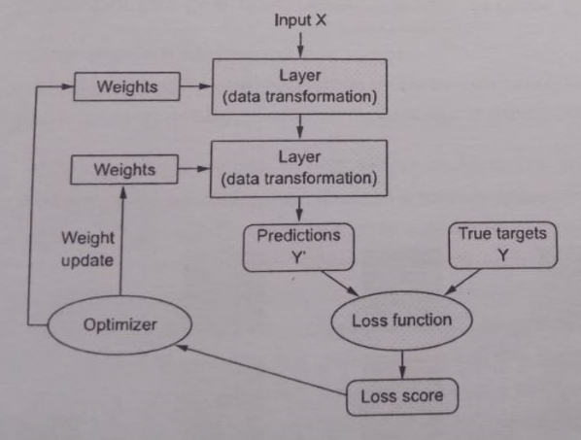
Areas of growth

Slide 6

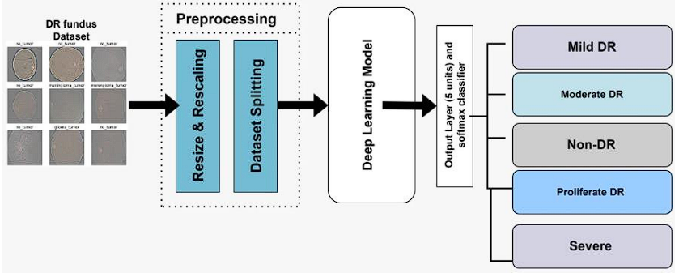
METHODOLOGY

Slide 7
Dataset description
 | APTOS DATASET |  | FUNDUS DATASET |  | HYBRID DATASET
 | Train | Val | Train | Val | Train | Val
Mild DR | 314 | 56 | 3 | 1 | 317 | 57
Moderare DR | 849 | 150 | 68 | 12 | 917 | 162
No DR | 1534 | 271 | 159 | 28 | 1693 | 299
Proliferate DR | 251 | 44 | 154 | 48 | 405 | 92
Severe DR | 164 | 29 | 240 | 44 | 404 | 73
(Total) | 3112 | 550 | 624 | 133 | 3726 | 683

Slide 8
Filters

Slide 9
optimizer

Slide 10
Batch size

Slide 11
image size

Slide 12
YOLOv8 classification models

Slide 13
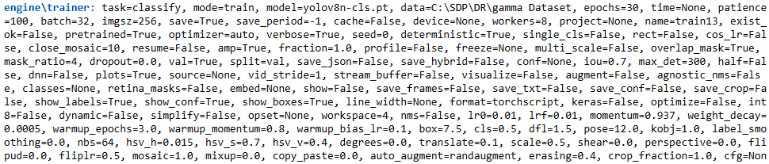
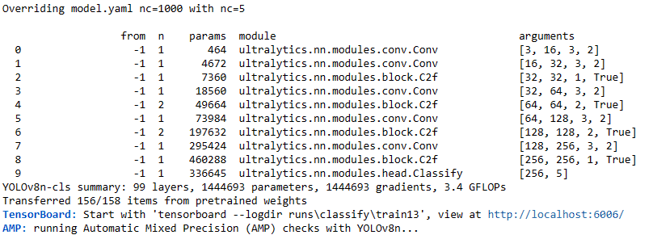
Model: YOLOv8n-cls

Slide 14
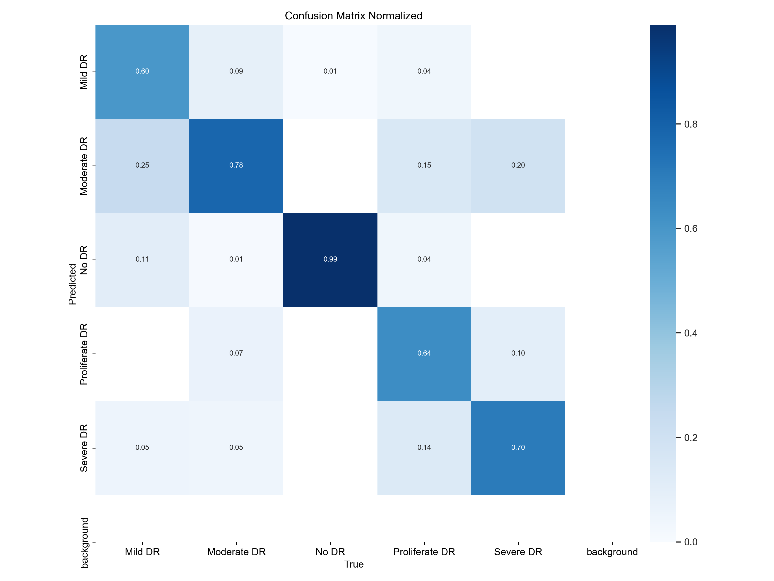
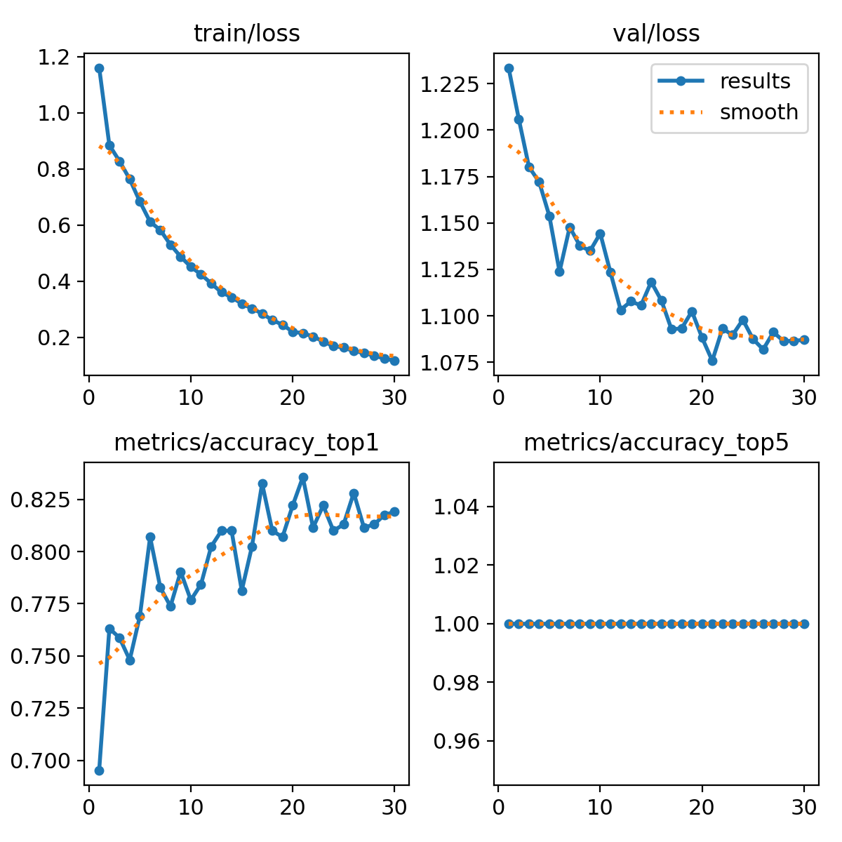
Yolov8n-cls Results

Slide 15
Classification results per epoch
epoch | train/loss | metrics/accuracy_top1 | metrics/accuracy_top5 | val/loss | lr/pg0 | lr/pg1 | lr/pg2
1 | 1.1605 | 0.69532 | 1 | 1.2336 | 0.003329 | 0.003329 | 0.003329
2 | 0.88474 | 0.7632 | 1 | 1.206 | 0.006442 | 0.006442 | 0.006442
3 | 0.82762 | 0.75867 | 1 | 1.1802 | 0.009336 | 0.009336 | 0.009336
4 | 0.76374 | 0.74811 | 1 | 1.1721 | 0.00901 | 0.00901 | 0.00901
5 | 0.68347 | 0.76923 | 1 | 1.1538 | 0.00901 | 0.00901 | 0.00901
6 | 0.61194 | 0.80694 | 1 | 1.1238 | 0.00868 | 0.00868 | 0.00868
7 | 0.58267 | 0.78281 | 1 | 1.1478 | 0.00835 | 0.00835 | 0.00835
8 | 0.53031 | 0.77376 | 1 | 1.1377 | 0.00802 | 0.00802 | 0.00802
9 | 0.48779 | 0.79035 | 1 | 1.135 | 0.00769 | 0.00769 | 0.00769
10 | 0.45135 | 0.77677 | 1 | 1.1444 | 0.00736 | 0.00736 | 0.00736
11 | 0.42479 | 0.78431 | 1 | 1.1234 | 0.00703 | 0.00703 | 0.00703
12 | 0.39231 | 0.80241 | 1 | 1.1032 | 0.0067 | 0.0067 | 0.0067
13 | 0.36125 | 0.80995 | 1 | 1.1078 | 0.00637 | 0.00637 | 0.00637
14 | 0.34319 | 0.80995 | 1 | 1.1056 | 0.00604 | 0.00604 | 0.00604
15 | 0.32076 | 0.7813 | 1 | 1.1183 | 0.00571 | 0.00571 | 0.00571
16 | 0.30327 | 0.80241 | 1 | 1.1083 | 0.00538 | 0.00538 | 0.00538
17 | 0.28528 | 0.83258 | 1 | 1.0927 | 0.00505 | 0.00505 | 0.00505
18 | 0.26193 | 0.80995 | 1 | 1.0933 | 0.00472 | 0.00472 | 0.00472
19 | 0.24551 | 0.80694 | 1 | 1.1024 | 0.00439 | 0.00439 | 0.00439
20 | 0.22037 | 0.82202 | 1 | 1.0882 | 0.00406 | 0.00406 | 0.00406
21 | 0.21532 | 0.8356 | 1 | 1.0758 | 0.00373 | 0.00373 | 0.00373
22 | 0.20363 | 0.81146 | 1 | 1.0931 | 0.0034 | 0.0034 | 0.0034
23 | 0.18576 | 0.82202 | 1 | 1.0897 | 0.00307 | 0.00307 | 0.00307
24 | 0.16938 | 0.80995 | 1 | 1.0979 | 0.00274 | 0.00274 | 0.00274
25 | 0.16457 | 0.81297 | 1 | 1.0875 | 0.00241 | 0.00241 | 0.00241
26 | 0.15145 | 0.82805 | 1 | 1.0819 | 0.00208 | 0.00208 | 0.00208
27 | 0.14531 | 0.81146 | 1 | 1.0912 | 0.00175 | 0.00175 | 0.00175
28 | 0.13497 | 0.81297 | 1 | 1.0864 | 0.00142 | 0.00142 | 0.00142
29 | 0.12532 | 0.8175 | 1 | 1.0865 | 0.00109 | 0.00109 | 0.00109
30 | 0.11707 | 0.819 | 1 | 1.0871 | 0.00076 | 0.00076 | 0.00076

Slide 16
Performance on raw dataset
 | APTOS Dataset |  |  |  | FUNDUS dataset
Models | Accuracy | Misclassification Rate | Macro-F1 | Weighted-F1 | Accuracy | Misclassification Rate | Macro-F1 | Weighted-F1
YOLOv8n-cls | 0.8509 | 0.1491 | 0.7069 | 0.8444 | 0.8195 | 0.1805 | NaN | NaN
YOLOv8s-cls | 0.8582 | 0.1418 | 0.7242 | 0.8517 | 0.8271 | 0.1729 | NaN | NaN
YOLOv8m-cls | 0.8473 | 0.1527 | 0.7222 | 0.8445 | 0.812 | 0.188 | NaN | NaN
YOLOv8l-cls | 0.8436 | 0.1564 | 0.7003 | 0.8407 | 0.812 | 0.188 | NaN | NaN

Slide 17

Timeline
JAN
FEB
Mar
Apr
May
Dataset gathering
Previous Research Finding
Finding better hyperparameters
Running different Models with the best suitable hyperparameters
Deploy and analyzing strategic networks

Slide 18

Areas of focus
ACCESSIBILITY
ENGAGIBILITY
Despite these advances, healthcare systems around the world continue to face many challenges, e.g. Access to Health Care: Access to quality health care is an important issue in many parts of the world, especially in rural and developing countries Geographical barriers, economic barriers, and lack of health professionals contributes to more care
Patients are increasingly demanding an active role in their health care decisions. But many health systems struggle to engage patients better and give them the information and tools they need to make informed decisions about their health.

Slide 19

Summary
AI and ML are used to develop intelligent systems that can analyze vast amounts of patient data, identify patterns, and provide relevant insights to healthcare professionals. This allows for more accurate diagnosis, prediction of risk factors for patients, and tailored treatment recommendations.

Slide 20

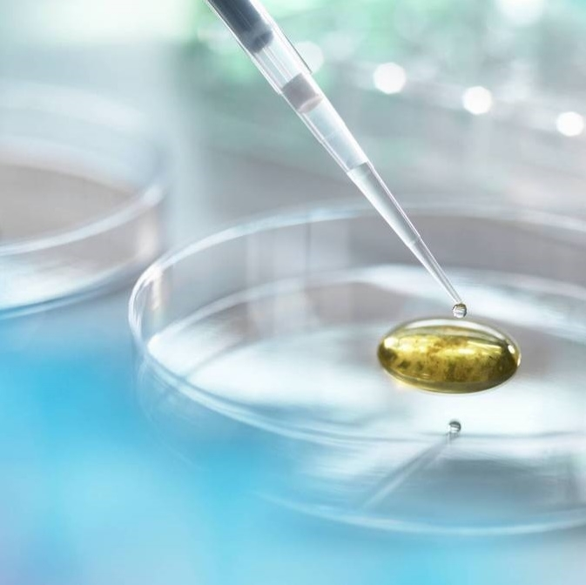
Thank you
RAGHAV AGARWAL​
Raghav.20bce7383@vitap.ac.in | SDP ID: 20240145

